Slide 1


WELLS OF LIFE
TANZANIA WATER WELLS PREDICTION

Slide 2
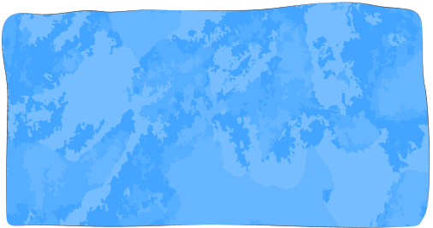

TABLE OF CONTENT
Overview
Evaluation
Business Understanding
Recommendation
Data Understanding
Next Steps
Modeling

Slide 3

OVERVIEW
Repository for predicting water well status in Tanzania for Wells of Life NGO
Goal: Efficiently identify wells needing repair for improved clean water access
Millions in Tanzania lack clean water, highlighting urgent need for effective maintenance prioritization
Utilizes machine learning algorithms for accurate well condition prediction
Benefits: Optimized resource allocation, proactive intervention, enhanced clean water access for communities

Slide 4
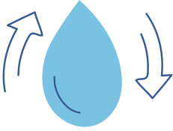
BUSINESS UNDERSTANDING
Purpose: Addressing the challenge faced by Wells of Life NGO in Tanzania to identify water wells needing repair
Context: Over 57 million Tanzanians struggle with clean water access, many wells require maintenance or have failed
Problem: Inefficient prioritization of maintenance due to limited resources and lack of systematic assessment
Solution: Develop a classifier using various data points (e.g., pump type, installation date) to predict well condition accurately
Impact: Optimized resource allocation, prioritized repairs, proactive intervention to prevent water supply disruptions
Outcome: Improved clean water access for Tanzanian communities

Slide 5
DATA UNDERSTANDING
Data Source: Provided dataset from Taarifa and the Tanzanian Ministry of Water
Description: Dataset enables analysis of factors such as pump type, installation date, and management practices to classify pumps into functional, in need of repair, or non-functional categories
Goal: Utilize dataset in an intermediate-level practice competition to enhance maintenance operations and ensure clean water access in Tanzania
Importance: Understanding dataset's source, properties, and suitability crucial for developing accurate predictive models
Opportunity: Apply machine learning techniques to improve water infrastructure management and enhance water accessibility in Tanzania

Slide 6





CRISP DM METHODOLOGY
Business Understanding
Data Understanding
Data Preparation
Modeling
Evaluation

Slide 7
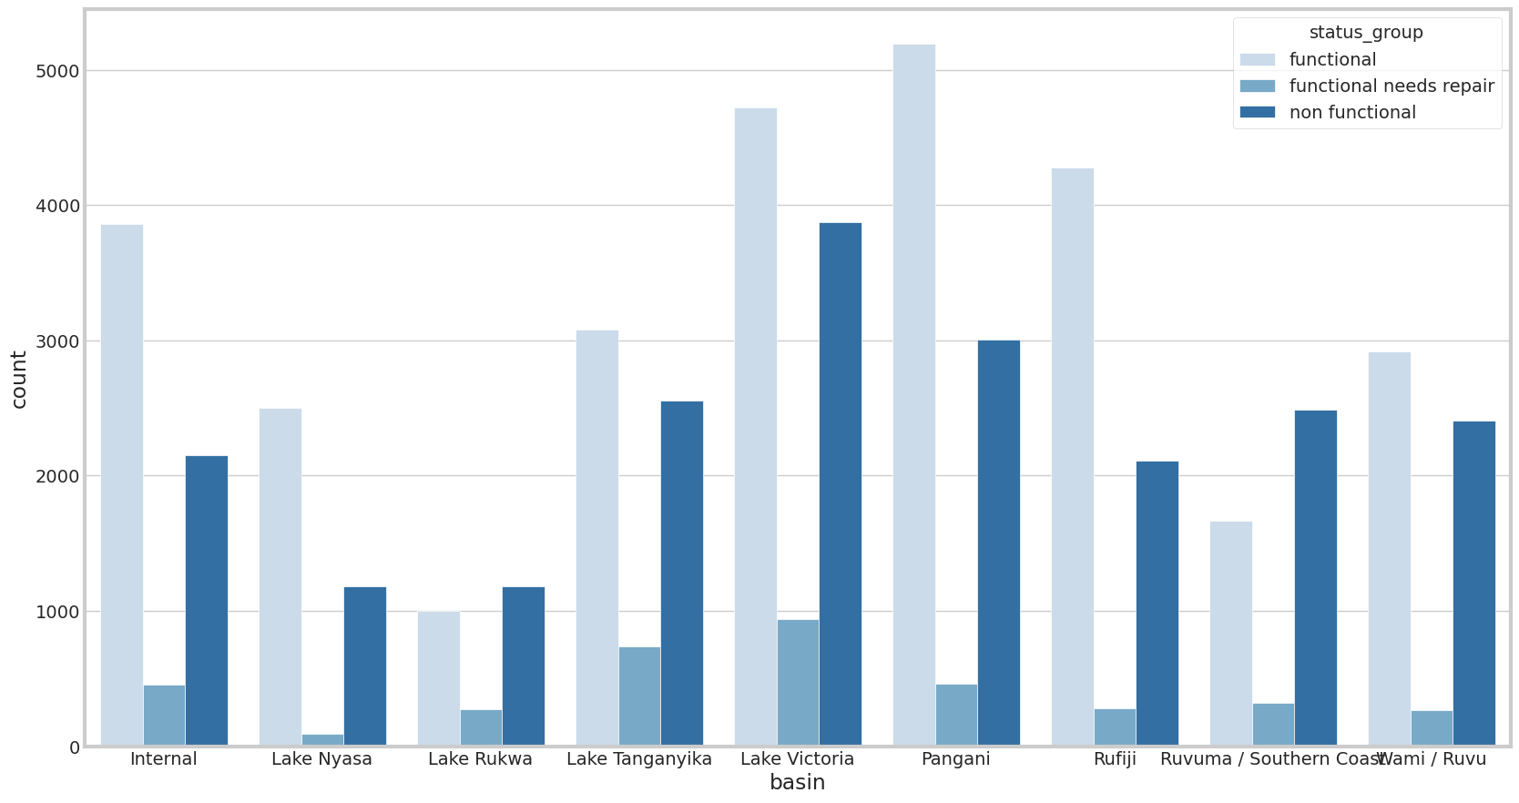
The colors correspond to the status groups: functional, functional needs repair, and non-functional.
The comparison allows for visualizing the relationship between basin and well functionality, providing insights into whether certain basins have a higher proportion of non-functional wells or if there are variations in functionality across different basins.

Slide 8
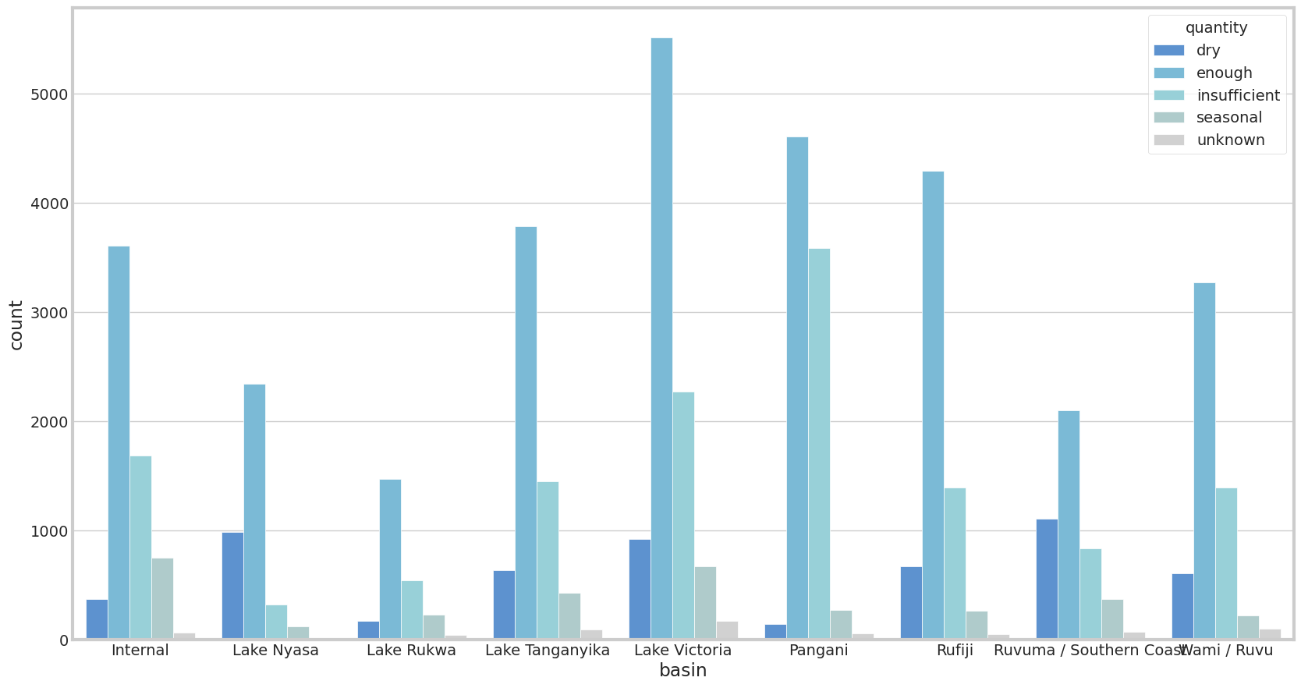
By visualizing the relationship between basin and water quantity, the plot allows for insights into whether certain basins tend to have more wells with abundant or scarce water quantities.

Slide 9
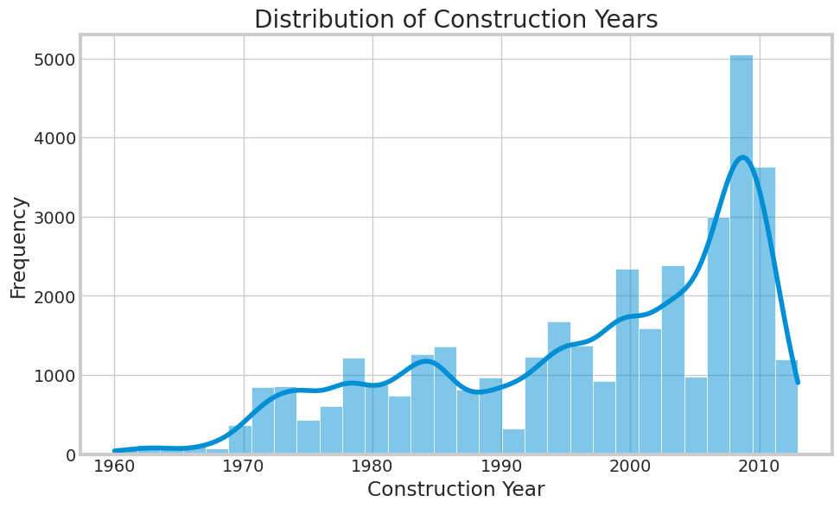
This visualization allows for understanding the distribution of well construction over time, providing insights into trends and patterns in the construction of water wells in Tanzania.

Slide 10
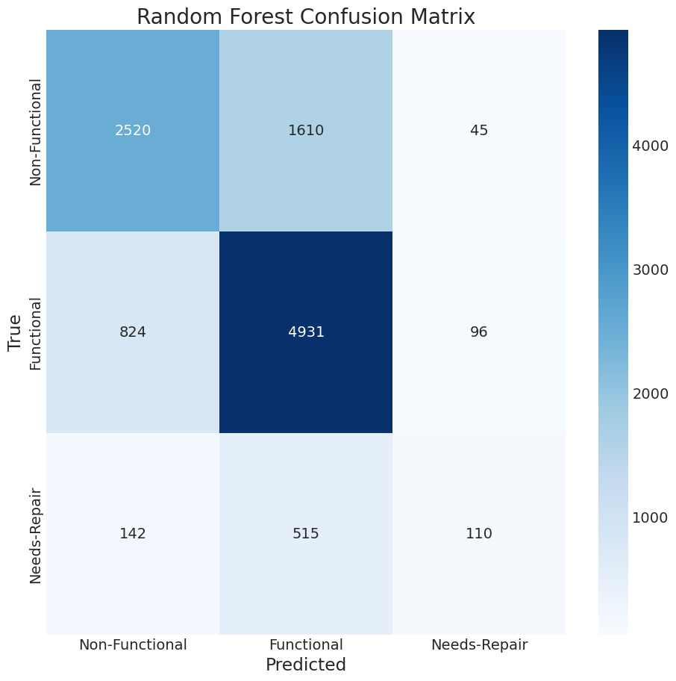
XGBOOST MODEL
Training Accuracy: 71.78% Validation accuracy: 70.17% Grid Search found the following optimal parameters: xgb__learning_rate: 0.2 xgb__max_depth: 6 xgb__min_child_weight: 1 xgb__n_estimators: 100 xgb__subsample: 0.7 Training Accuracy: 71.61% Validation accuracy: 70.06%

Slide 11

RECOMMENDATIONS
Feature Engineering: Explore new features or enhance existing ones to provide better predictive insights.
Handle Class Imbalance: Implement techniques to address class imbalances in the dataset.
Ensemble Methods: Utilize ensemble methods to combine the strengths of multiple models.
Hyperparameter Tuning: Fine-tune model hyperparameters, particularly for algorithms like XGBoost.
Explore Advanced Models: Experiment with more sophisticated models like neural networks or gradient boosting machines.
Data Augmentation: Increase dataset diversity through data augmentation techniques.
Evaluate Model Interpretability: Ensure model predictions are interpretable to stakeholders through methods like SHAP values.
Continual Monitoring: Establish a system for ongoing model monitoring and updating to maintain relevance.

Slide 12


THANK YOU

